Slide 1
Capstone Design Project
Reponse of Feedbacks
Team: Jjangdol
2016314474 윤성빈 2016310703 남득윤
2016314668 위성은 2018310656 이다솔

Slide 2
GAN단한 폰트제작기
GANdanhan font maker

Slide 3
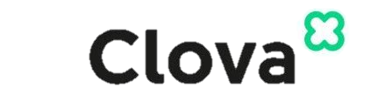
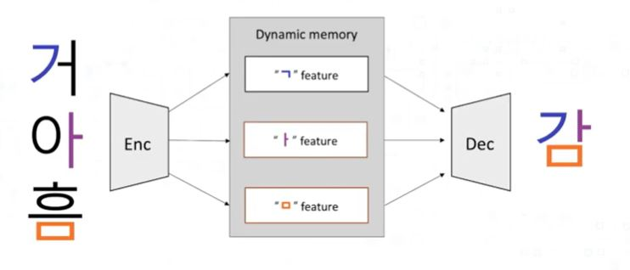
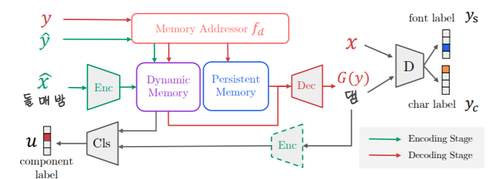
01
Feedback
[-] lack of distinguishing points from the existing idea or service
[-] many alternatives (overlapping idea)
Increase user satisfaction by complementing the output of font design
Applying Ensenble method on DM-font → AdaGAN
Retraining in a way that gives a higher weight to the glyph that the user is dissatisfied with.
Provide Web-service in free and increase convenience
[-] lack of study on prior work, especially the one from Naver
We already introduced Naver font project in previous presentation for the applying technique
Naver DM-font use few-shot model
The few-shot-model has a style image as a parameter to divide one letter into initial, medial, and final consonant while the many-shot model uses a style label as a parameter.
[compositionality of Korean script]
[Architecture overview]

Slide 4
01
Feedback
[-] comparison with other techniques not using GAN
An example of font generators that do not use GAN is CNN style transfer
However, CNN style transfer is not suitable for our project
it is specialized in English that go through a simple task of converting only a-z case letters
Hangeul should create more than 10,000 glyphs by combining of initial, medial, and final consonant
[-] 300-400 user inputs might be too much
[-] the output might not be worthwhile considering the efforts to be made
We agree that 3-400 letters of input can be a burden to the user according to individual capacity
However, Considering that our project can generate more than 10,000 letter of font and the time and cost of creating fonts previously, it seems to be reasonable to require 2-300 inputs.
It is a worthwhile web project for people or startup companies who want their self branding

Slide 5
02
Comments Q&A
Q. Is there any free of charge API for Optical Character Recognition (OCR) that recognizes Korean?
OCR; a technology that literally recognizes handwriting, printed letters, and converts them into text format
There are many free APIs that provide OCR, but we will not apply OCR in our projects
Q. Are you going to apply the same model proposed by GlyphGAN?
As you stated, the model may not work well for Korean characters. Maybe you need a better model.
No. We will not apply the model proposed by GlyphGAN
We introduce GlyphGAN as a prior work of font generation, not for an applying model for our project.
Instead, We are going to use Dual Memory-augmented Font Generation Network (DM-Font) which is specialized in Korean letters.

Slide 6
02
Comments Q&A
Q. Can you provide a project plan with a timeline (e.g., week1, week2, …) as well as members and roles?
 | week1 | Week2 | Week3 | Week4 | Week5 | Week6 | Week7 | Week8 | Week9 | Week10 | Week11
 | 9/27-10/2 | 10/4-10/9 | 10/11-10/16 | 10/18-10/23 | 10/25-10/30 | 11/1-11/6 | 11/8-11/13 | 11/15-11/20 | 11/22-11/27 | 11/29-12/4 | 12/6-
Complete Proposal with Feedback
Implement Component
Application of GAN
Create ttf. Format file
Create Web
Integration
Code Review
Testing
Launching
Deuk Yun
Seong Bin
Da sol
Sung Eun
Deuk Yun
Da sol
Seong Bin
Seong Bin
Sung Eun
Deuk Yun
Deuk Yun
Seong Bin
Da sol
Sung Eun
Da sol
Seong Bin
Sung Eun

Slide 7
Thank you

